Slide 1



HIV-1 transcription in live
T-Lymphocytes
Raphael Tranchot M2 Bioinformatics
Eugenia Basyuk Supervisor
Antiviral drug development, viral replication and regulation team (Andevir)
Laboratoire de Microbiologie Fondamentale et Pathogénicité

Slide 2
Table of Contents
Context of the internship
Presentation of the data
Goals
Materials and Methods
Pipeline
Results
Conclusions

Slide 3
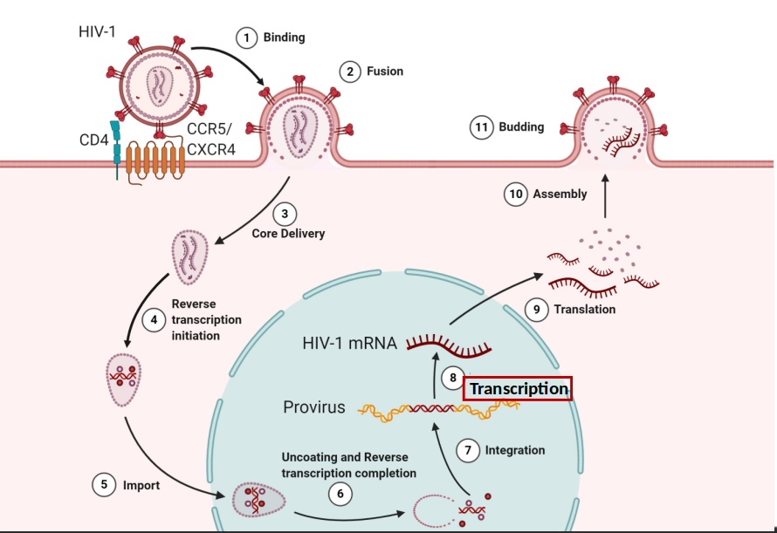
Context of the intership
Cycle of replication of HIV-1
Source : Ramdas et al, 2020

Slide 4
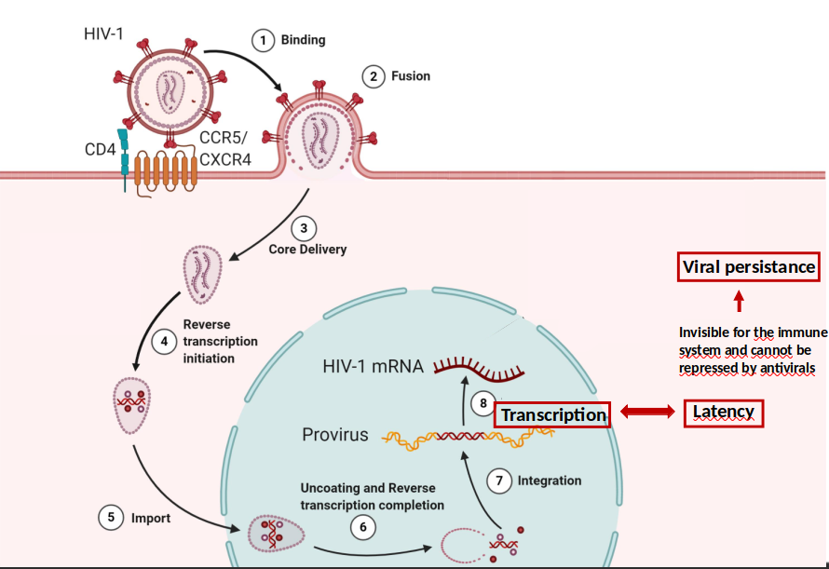
Context of the intership
Cycle of replication of HIV-1
Source : Ramdas et al, 2020

Slide 5
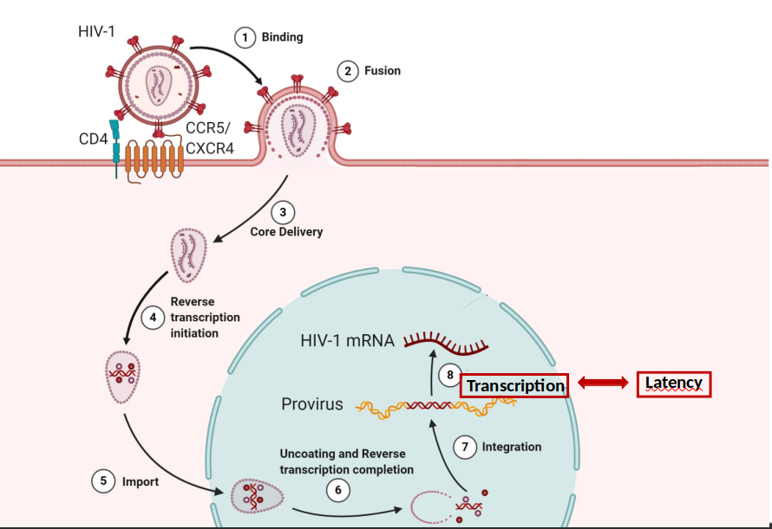

Context of the intership
Cycle of replication of HIV-1
Switch between transcription and latency is stochastic
Source : Ramdas et al, 2020

Slide 6
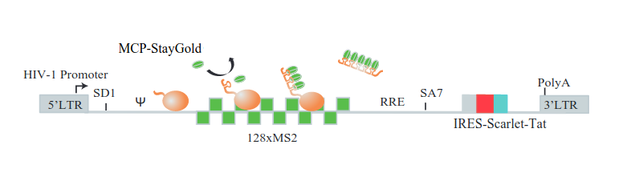



Presentation of data
Experimental system
RNA MCP-Staygold
Scarlet-Tat
Merge
Jurkat cells clones

Slide 7
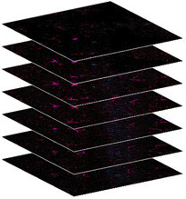
Presentation of data
Live cells movies
Spacing of 700 nm
z
Hyperstack of shape [t,z,y,x]
y
x
1 3D Stack/minute
2 and 12 hours long
t

Slide 8
Goal
Quantify number of nascent RNA at Transcription sites (TS) throughout the movie :
→ Required to establish a model of promoter function and elucidate mechanisms of switching between active and latent viral states

Slide 9


Materials and Methods
Programming languages

Slide 10




Materials and Methods
Programming software
Imaging software
Python packages
BigFish
& BigFishLive
(by R. Topno)
Cellpose
Ultrack
Image manipulation
Cell segmentation and tracking
Detection and quantification of fixed images of smFISH

Slide 11
Pipeline
Preparation of the movies
Segmentation
Detection
and
Quantification

Slide 12
Preparation of the movies
Preparation of the movies
Segmentation
Detection
and
Quantification

Slide 13
Preparation of the movie
In most movies photo-bleaching occurs, this phenomenon is more pronounced in long movies (12h)
→ Photo-bleaching correction using ImageJ

Slide 14
Segmentation
Preparation of the movies
Segmentation
Detection
and
Quantification

Slide 15
Segmentation
Segmentation of cells in each frame
Cell tracking to assign a label to every cell
Sorting of cells
Cell cropping to create individual file for each cell

Slide 16
Segmentation and tracking
Detection of the cells outlines throughout the movie
Assign a label to each cells

Slide 17
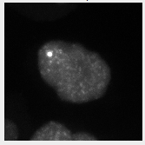
Segmentation parameters
Few parameters :
diameter : diameter of the cell in pixel = 100
model : ‘cyto’ or ‘nuclei’
Big nucleus
Small cytoplasm

Slide 18
Tracking parameters
Few parameters :
max_distance : max distance between cells (in pixel) = 15
Appear_weight, disappear_weight, division_weight :
penalties = -0.001

Slide 19
Selection of the cells
Selection :
→ Only the cells present throughout the whole movie are conserved for the detection

Slide 20
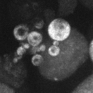
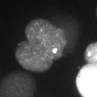
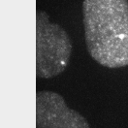
Elimination of the cells
Elimination of :
Dead cells
Overlapping cells
Cells at the
border
→ Implementation of semi-automated correction methods

Slide 21
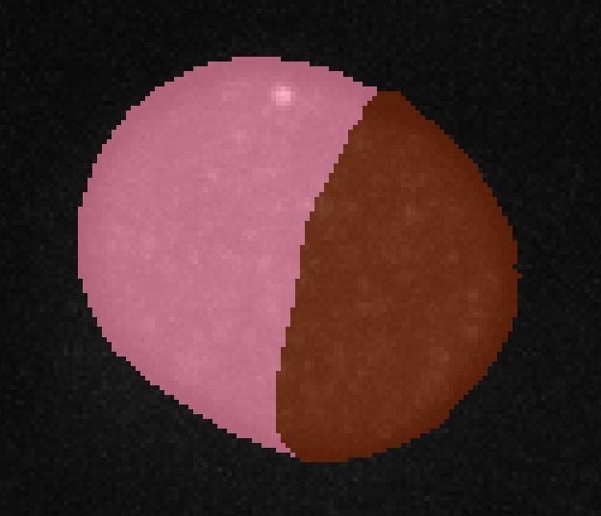
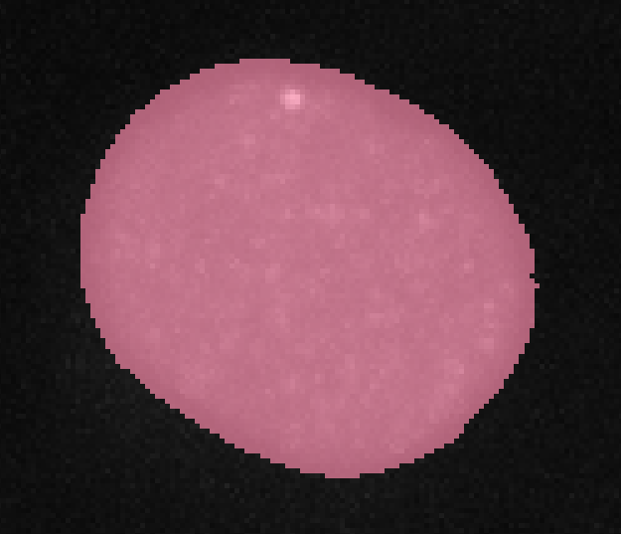
Fusion of the cells
→ Implementation of semi-automated correction methods

Slide 22
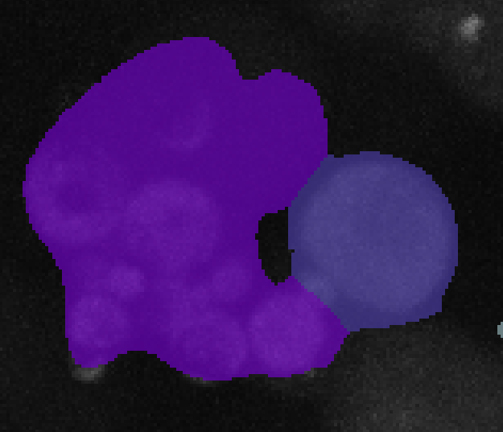
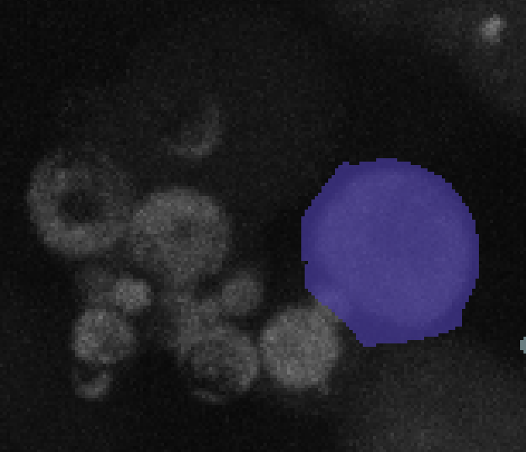
Elimination of the cells
→ Implementation of semi-automated correction methods

Slide 23
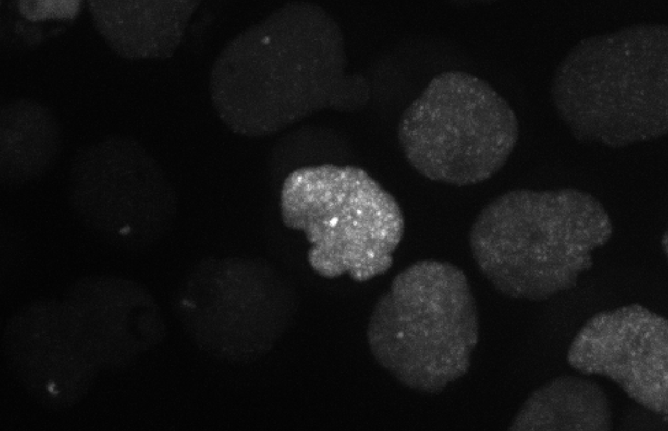

Segmentation and cropping of the cells
For each cell create an individual movie
labels to identify each cell throughout the movie
Cropped movie for one cell
Original movie

Slide 24
Segmentation and cropping of the cells
New cropping method :
Centering of the cell throughout the movie (computing centroids)
Cropping the cell and associated masks
→ Smaller files

Slide 25
Detection and Quantification
Preparation of the movies
Segmentation
Detection
and
Quantification

Slide 26
Detection
Spot = single molecule of RNA
Clusters = accumulation of single molecules in a radius
Inside nuclei
Outside nuclei
Transcription site (TS)
Foci

Slide 27
Detection
Detection of single molecules
Computing of the reference spot (*)
Detection of TS (*)
Computing of RNA number at TS
* Use of the cropped masks

Slide 28
Detection
Detection of single molecules
Computing of the reference spot (*)
Detection of TS (*)
Computing of RNA number at TS
Why ?
* Use of the cropped masks

Slide 29
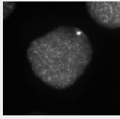
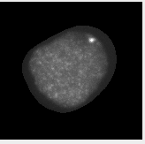
Use of the cropped masks

Slide 30
Parameters of detection
Voxel radius = (700, 110, 110)
Object radius = (700, 105, 105)
Threshold = threshold of intensity for spot detection
(specific for each cell)

Slide 31
Parameters of detection
Multiplication factors
α = influence the number of spots per region candidates
β : for threshold of dense region
threshold = β * (median spot)
ɣ : kernel size for Gaussian filter
kernel size = (ɣ * spot radius)/voxel size

Slide 32
Parameters of detection
Multiplication factors
α = influence the number of spots per region candidates
β : for threshold of dense region
threshold = β * (median spot)
ɣ : kernel size for Gaussian filter
kernel size = (ɣ * spot radius)/voxel size
α = 0.5, β = 2, ɣ = 15

Slide 33
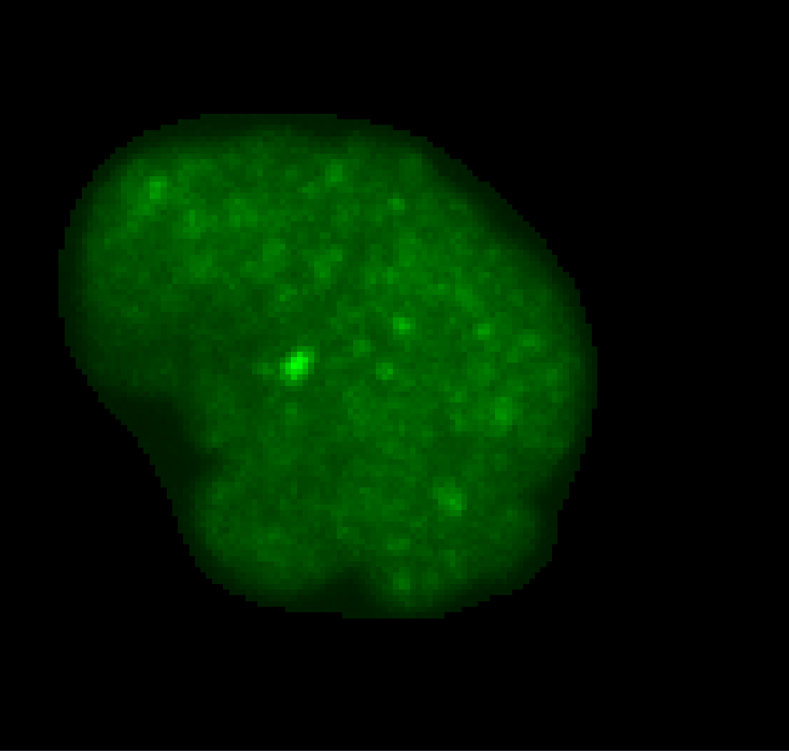
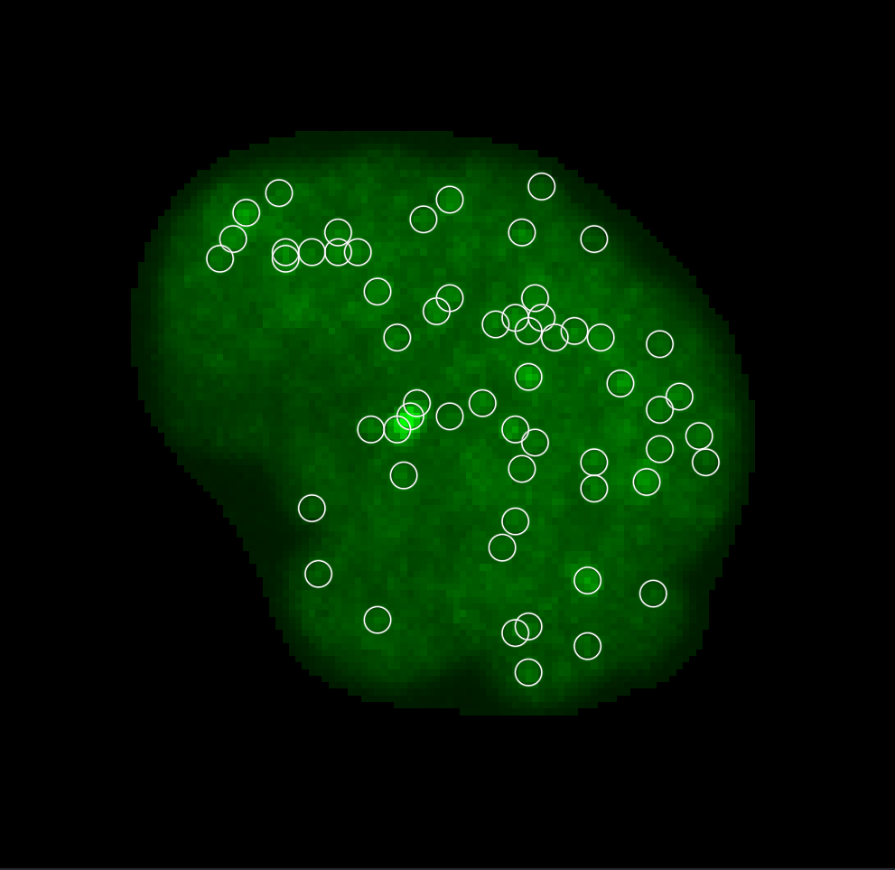
Detection of single molecules
We get all spots throughout the movie = single molecules

Slide 34
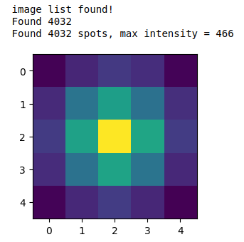
Build reference spot
Using all spots we obtain a reference spot, which is the image of the average RNA molecule throughout the movie for each cell
Number of spots in the cell
Intensity of the reference spot

Slide 35
Detection and Quantification of TS
Detection of multiples TS candidates (at least 2 molecules in 400 nm)
Sorting TS by intensity
Computing of RNA number at TS

Slide 36
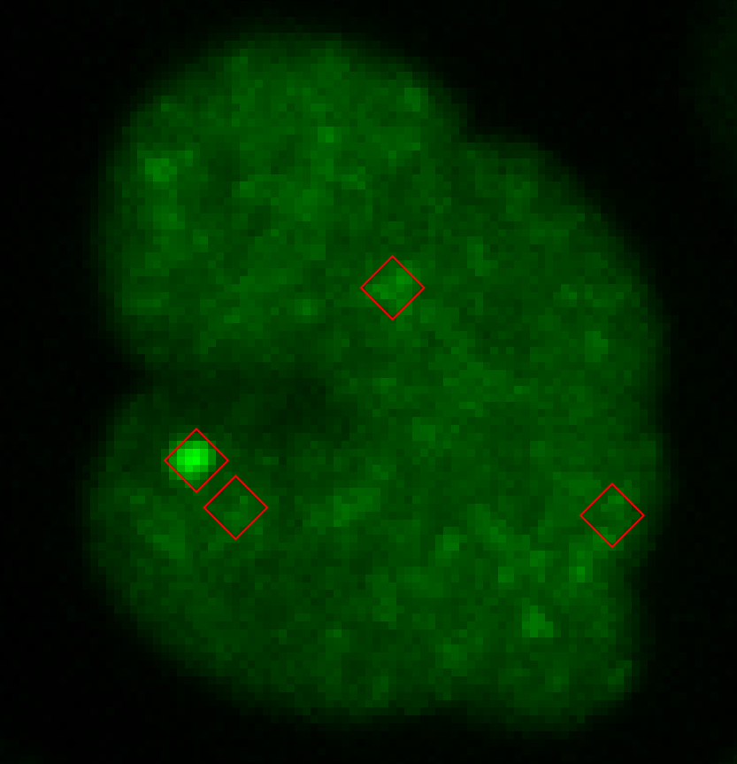
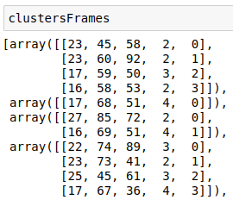
Detection of multiples candidates
Need to sort the candidates by intensity

Slide 37
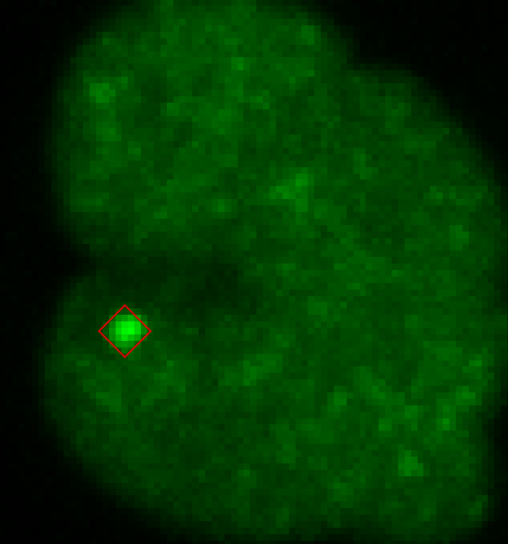
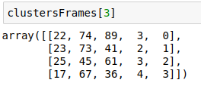
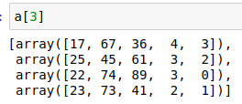
Sorting TS by intensity
Need to sort the candidates by intensity
Before sorting
After sorting

Slide 38
Sorting TS by intensity
Need to sort the candidates by intensity

Slide 39
Detection of transcription sites
We detect transcription sites throughout the movie

Slide 40
Computing of RNA number at TS
A TS is a tridimensional structure which changes the shape, the volume and the intensity
Generally one per cell but is duplicated during G2 phase of cell cycle
→ These specificities should be taken into account for the quantification

Slide 41
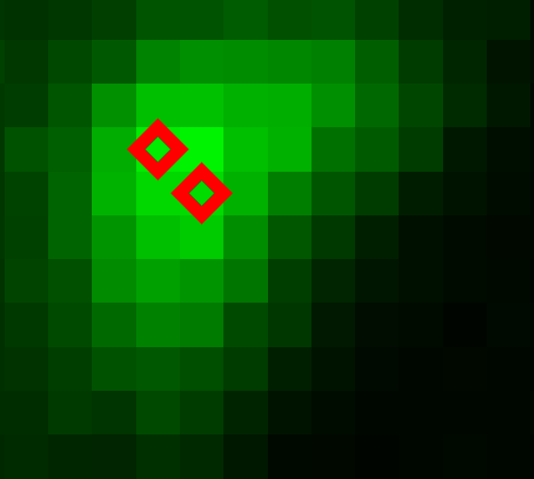
Computing of RNA number at large TS
Computing neighbors clusters candidates together
Possibility to choose :
2 radius (in xy and z) → xy=5, z=1
a threshold of intensity → 1000
a percentage of tolerance → 50%

Slide 42


Computing of RNA number at large TS
Sum of the number of molecules

Slide 43
Results
z | y | x | n_molecule | Time (min)
17.0 | 60.0 | 54.0 | 4.0 | 0.0
17.0 | 72.0 | 54.0 | 4.0 | 1.0
16.0 | 75.0 | 59.0 | 4.0 | 2.0
17.0 | 69.0 | 29.0 | 4.0 | 3.0
18.0 | 71.0 | 25.0 | 3.0 | 4.0
0.0 | 0.0 | 0.0 | 0.0 | 5.0
17.0 | 41.0 | 41.0 | 5.0 | 6.0
18.0 | 35.0 | 36.0 | 5.0 | 7.0
18.0 | 42.0 | 47.0 | 6.0 | 8.0
17.0 | 50.0 | 58.0 | 4.0 | 9.0
17.0 | 46.0 | 66.0 | 4.0 | 10.0
Quantification of TS in csv files

Slide 44
Conclusion
We went from :
A time consuming and manual cell segmentation and TS detection
To :
A semi-automated segmentation and TS detection
Accurate quantification of TS
Currently :
Working on full movies (12h)
Cleaning my code

Slide 45
Applications and perspectives
→ The segmentation can be used for other imaging applications in live cells
→ The pipeline can be adapted to detect any small spots containing several fluorophores
Need programming skills
Perspective : Possibility to turn it into a plugin or a software

Slide 46
Special thanks
MFP Andevir team
HIV Transcription Project :
Eugenia Basyuk
Alexia Damour
Marie-Line Andreola
Mathieu Metifiot
Patricia Recordon-Pinson
Floriane Lagadec
Chloé Torres
Akintha Ganot
Enola Réaud
MFP SpacVir team
Nicolas Landrein
Collaborators :
Rachel Topno (IGH Montpellier)
Edouard Bertrand (IGH Montpellier)
Ovidiu Radulescu (LPHI Montpellier)
LABRI Bordeaux :
Marie Beurton-Aimar
Computer time for this study was provided by the computing facilities of the MCIA (Mésocentre de Calcul Intensif Aquitain)

Slide 47
Thank for your attention

